Slide 1
Do Additional Variables Improve the Accuracy of Total Population Forecasts Generated by Global Machine Learning
Group 12
Industry Partner: Dr Irina Grossman
Project Supervisor: Prof Michael Kirley
Presented by: Chi Zhang, Haitong Gao, Yuexin Li, Eric Luanzon, Meijun Yue

Slide 2
Presentation Outline
Project Team Introduction
Industry Client Introduction and Requirements’ Illustration
Challenges of the Data Science Project
Literature Review of Population Forecasting & Long-Short Term Memory
Data Science Pipeline (Data, Model, Result)
Conclusion & Recommendation

Slide 3





Team Introduction
Chi Zhang
Eric Luanzon
Haitong Gao
Meijun Yue
Yuexin Li
Work Coordinating
Data Analysis
Data Reconstruction
Benchmark Model
LSTM
Model’s Evaluation
Report Writing
Data Preprocessing
Potential Model
Model Testing
LSTM
Parameters’ Tuning
Report Writing
Forecast Reconciliation
Reference Collecting
LSTM
Model’s Improvement
Multivariate Implement
Report Writing
Data Visualisation
Data Reconstruction
Model Testing
Data Splitting
LSTM
Report Writing
Meeting Agenda Arranging
Data Visualisation
Data Reconstruction
LSTM
Multivariate Implement
Model’s Improvement
Report Writing

Slide 4
Project Background
Population Forecasting: Planning, Marketing, Research etc.
Current Outstanding Model: Synthetic Migration Model
Global Machine Learning Model: Long-Short Term Memory (LSTM)
Target: Construct a LSTM Model on Forecasting the Small Area (SA3) Population in Age-Sex Cohort
Other Requirement: Comparison between LSTM and Synthetic Migration Model

Slide 5
Challenges
1. Data Sparsity (Unstable Trend)
2. Short Time-Series (Insufficient amount of Data)
3. Less Feature Input for the LSTM Model (Compare with the Benchmark)
4. Lower Interpretability of Model (Weights during training are not interpretable)
5. Computational Consumption (Epoch)
6. Error Stack Issue (Retraining & Rolling Update)
7. Input Structure (Format)

Slide 6
Literature Review
Hamilton-Perry Model Could be implemented without migration data, easy to implement. But less detail output
Synthetic Migration Model Age-Sex Cohort population forecasting with birth, death, migration rate and total population constraints
Long-Short Term Memory (LSTM) Long Term Dependencies

Slide 7
Synthetic Migration Model
Constraint Forecast with the total population (National Projection) in each area
Change the inward migration flows to maintain consistency
Apply extra 4 models for creating projection total population data
Migration Rate, Birth Rate, Death Rate are considered
Area’s independence

Slide 8
Synthetic Migration Model
Data Source: Based on SA3 Age-Sex Cohort Data (2 * 18 of Age-Sex Cohorts)
Investigate Area: 325 Area (Above 1000) + 1 Remainder (Aggregated Below 1000)
Difference from LSTM: More Features / Variables for Forecasting Fertility Rate, Mortality Rate, Migration Rate SmallAreaTotal Population from Average-4-Model’s Result
Forecast Result: 2006, 2011 Age-Sex Cohort’s Population

Slide 9
Data Science Pipeline
Data Collection
Data Preparation & Description & Analysis
Data Modelling and Validation
Model Deployment on New Data
Comparison & Reviewing

Slide 10
Data Collection & Description
All Data are Preliminarily Cooked by Client from the Australia Bureau of Statistic
Data Scale — SA3 (Statistical Area Level 3)
Data Format — Age-Sex Cohort’s Population in Each Area (351 Areas)
Time Series Data — Record from 1991 to 2011
Above_1000 Area — Area with Above 1000 Total Population in Every Year
Below_1000 Area — Area with Less than 1000 Total Population in One Year

Slide 11
Data Description
Age Cohorts
0-4 | 5-9 | 10-14 | 15-19 | 20-24 | 25-29 | 30-34 | 35-39 | 40-44 | 45-49 | 50-54 | 55-59 | 60-64 | 65-69 | 70-74 | 75-79 | 80-84 | 85+
Each Region’s Time-series in one year: 2 * 18 (Sex Cohort * Age Cohort)
SA3 Code | SA3 Name | m0-4 | m5-9 | m10-14 | m15-19 | m20-24 | m25-29 | … | m60-64 | m65-69 | m70-74 | m75-79 | m80-84 | m85+
10101 | Goulbum Yass | 2603 | 2565 | 2517 | 2472 | 2178 | 2392 | … | 1513 | 1170 | 765 | 506 | 260 | 159
10102 | Queanbeyan | 1593 | 1362 | 1223 | 1406 | 1743 | 1803 | … | 617 | 478 | 330 | 198 | 95 | 43
… | … | … | … | … | … | … | … | … | … | … | … | … | … | …
Partial Dataframe (Male Group in 1991)

Slide 12
Data Description
Year | SA3 Name | Total
1991 | Goulburn - Yass | 61667
1991 | Queanbeyan | 35281
… | … | …
1992 | Goulburn - Yass | 61751
1992 | Queanbeyan | 36409
… | … | …
2011 | Goulburn - Yass | 69775
2011 | Queanbeyan | 56051
… | … | …
1991
-
2011

Slide 13
Above_1000 & Below_1000 Area — Preliminary Preprocessing
Above_1000
SA3 Code | SA3 Name
10101 | Goulburn - Yass
10102 | Queanbeyan
10103 | Snowy Mountains
10104 | South Coast
10201 | Gosford
10202 | Wyong
10301 | Bathurst
10302 | Lachlan Valley
10303 | Lithgow - Mudgee
10304 | Orange
… | …
Below_1000
SA3 Code | SA3 Name
10702 | Illawarra Catchment Reserve
10803 | Lord Howe Island
12402 | Blue Mountains - South
19797 | Migratory - Offshore - Shipping (NSW)
19999 | Special Purpose Codes SA3 (NSW)
29797 | Migratory - Offshore - Shipping (Vic.)
29999 | Special Purpose Codes SA3 (Vic.)
39797 | Migratory - Offshore - Shipping (Qld)
39999 | Special Purpose Codes SA3 (Qld)
49797 | Migratory - Offshore - Shipping (SA)
… | …
(Aggregate to Remainder Area)

Slide 14
Data Analysis – Descriptive Statistic
Time-Series Data (21 Years) — 11 Years for Training & 10 Years for Testing
Maximum & Minimum Value of Total Population — Min = 0 ; Max = 190621
Population Distribution (Pyramid Plot) among each Age-Sex Cohort
Population Growth’s Trend (Trend Plot) in Each Area

Slide 15
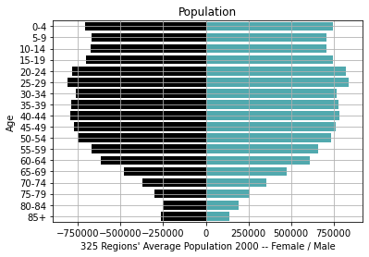
Data Analysis – Data Sparsity
Elder Age-Sex Cohorts Population’s Lacking (Visualisation of Anchor Year 2000)

Slide 16
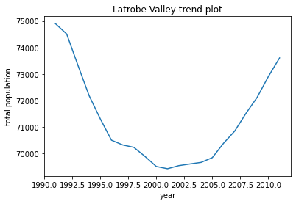
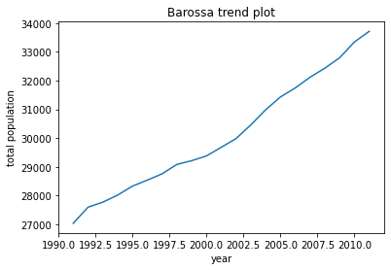
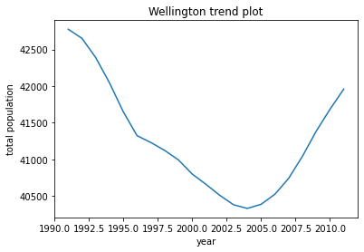
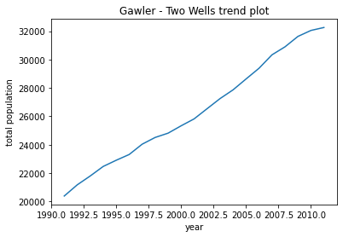
Data Analysis – Population Trends & Clustering
Data Trends – Region’s Population Growth Trends’ Difference / Similarity
Latrobe Valley vs. Barossa
Wellington vs. Gawler Two Wells

Slide 17
Characteristic of Data
Short Time-Series for Training
Sparse — Less Population in Elder Age Cohorts for both Male & Female
Different in Changing Trend — Hard to fit Model with Same Fixed Parameters
Dependency among Age or Sex Cohorts

Slide 18
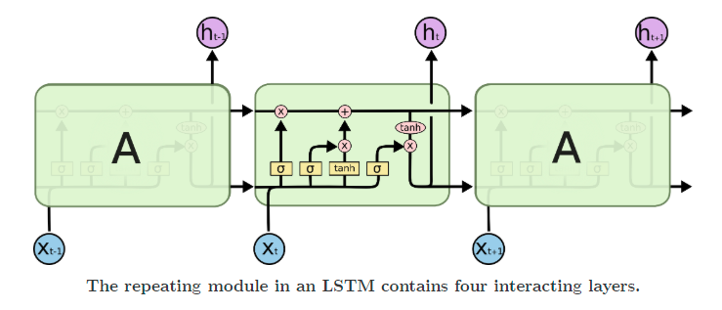
Long-Short Term Memory (LSTM)
LSTM Basic Structure (3 Gates)
Input Gate
Forget Gate
Output Gate
Age & Sex Prediction
Scaled input data
Decide time step
Unidirectional
Multivariate Input

Slide 19
Python Package(s)
TensorFlow — LSTM Package — Model's Framework
Tuning / Learning Rate & Auto-Stop — Model’s Hyper-parameter(s)
Random Seed — Model’s Reproducibility

Slide 20
Training & Validation & Test in LSTM
Training Set — 1991 - 2001 Training & Validation Split Varies During Model’s Tuning (i) LSTM Model Basic (Type 1) — 1991-1998 Training, 1999-2001 Validation (ii) LSTM Model Implemented (Type 2 & 3) — Random Splitting (iii) LSTM Model Extra Implemented (Type Extra) — Random Splitting
Test Set — 2002 - 2011 Models’ Evaluation Comparison only Processed in 2006, 2011

Slide 21
LSTM Model Basic (Type 1)
Sliding Window: 1, 3 Window Gap
Multivariate Input (2 LSTM Models * 18 Age-Cohort List Input)
Validation Set: 1999 - 2001
Fitting & Forecasting Rolling Update with Fixed Length Training Set & Fitted Model Epoch = 1000
Computational Consumption (Large)

Slide 22
LSTM Model Implementation (Type 2 & 3)
Extra Implementation (i) Scaling — No Improvement / Introduce Risk (ii) Non-Negative — Reasonable Application (No Negative Population) (iii) Random-Splitting — Allows Best Year(s) to be Included for Model Fitting (iv) Learning Rate / Auto-Stop — No Significant Improvement (v) Extra Features — Birth Rate & State & Average Total Population

Slide 23
LSTM Model Extra (Type Extra)
Sliding Window with Step = 1
Gap = 5
Inherit Implementation from the Standard Model (Type 2)
Only Predict the Population in 2006 & 2011 (Special Offer)
Reduce Computational Consumption (Measured in big O)
Increase Prediction Accuracy

Slide 24
Evaluation (Error Measures)
Absolute Percentage Error (APE) among each Age-Sex Cohort $APE_{age-sex}=\underset{s}{∑}\underset{a}{∑}(F_{s,a}-A_{s,a})/A*100\%$
$F_{s,a}$ = Forecast Population of the Age-Sex Cohort (e.g. Forecast Area 10101 Male 0-4) $A_{s,a}$ = True Population of the Age-Sex Cohort (e.g. True Area 10101 Male 0-4) $A$ = Total of True Population of the Selected Area (e.g. True Area 10101)
Notes:
5-10 Years Training set
5 Years Test set
New Data From ABS (2021)
New Model’s performance compares with benchmark

Slide 25
Result Table (Basic vs. Benchmark)
LSTM Basic Model (Type 1)
Benchmark Model
LSTM Type 1 (Step = 3)
 | Age-Sex Level | Total Level
mean_2006 | 16.1709 | 14.8950
median_2006 | 12.4672 | 13.0478
percentile_90_2006 | 33.1622 | 21.8927
mean_2011 | 25.6209 | 24.4915
median_2011 | 19.9009 | 20.5182
percentile_90_2011 | 51.8375 | 39.7218
Synthetic Migration Model
 | Age-Sex Level | Total Level
mean_2006 | 7.0493 | 6.5987
median_2006 | 4.7671 | 5.2553
percentile_90_2006 | 15.4181 | 11.0650
mean_2011 | 11.4899 | 11.4337
median_2011 | 8.1259 | 9.4145
percentile_90_2011 | 25.4696 | 18.8916
Higher Error Rate than the Synthetic Migration Model (Benchmark)

Slide 26
Result Table (Basic vs. Implementation)
LSTM Basic Model (Type 1)
LSTM Implemented Model (Type 2)
LSTM Type 1 (Step = 3)
 | Age-Sex Level | Total Level
mean_2006 | 16.1709 | 14.8950
median_2006 | 12.4672 | 13.0478
percentile_90_2006 | 33.1622 | 21.8927
mean_2011 | 25.6209 | 24.4915
median_2011 | 19.9009 | 20.5182
percentile_90_2011 | 51.8375 | 39.7218
LSTM Type 2 (Step = 3)
 | Age-Sex Level | Total Level
mean_2006 | 13.3995 | 12.2033
median_2006 | 9.4548 | 9.7856
percentile_90_2006 | 26.6544 | 19.5631
mean_2011 | 22.3879 | 21.2186
median_2011 | 16.2436 | 16.5910
percentile_90_2011 | 44.4078 | 33.8293
Decrease Around 3% of Error Rate from the Median Perspective

Slide 27
Result Table (Basic vs. Extra + Implementation)
LSTM Basic Model (Type 1)
LSTM Extra Model (Type Extra)
LSTM Type 1 (Step = 3)
 | Age-Sex Level | Total Level
mean_2006 | 16.1709 | 14.8950
median_2006 | 12.4672 | 13.0478
percentile_90_2006 | 33.1622 | 21.8927
mean_2011 | 25.6209 | 24.4915
median_2011 | 19.9009 | 20.5182
percentile_90_2011 | 51.8375 | 39.7218
LSTM Type Extra (Step = 1, Gap = 5)
 | Age-Sex Level | Total Level
mean_2006 | 11.8885 | 10.6295
median_2006 | 8.6265 | 9.0743
percentile_90_2006 | 23.5991 | 15.4323
mean_2011 | 18.4228 | 17.4967
median_2011 | 14.2963 | 15.0642
percentile_90_2011 | 36.9972 | 24.9798
Decrease Around 4% of Error Rate from the Median Perspective
Negligible Difference between the Unscaled and the Scaled Version of the Extra Model

Slide 28
Recommendation
Recommend (i) External Variable Improvement (ii) Easy Application without Complicate Coding
Not Recommend (i) Performance — Does not Outperform than the Benchmark (ii) Data Characteristic — Too Short Time-Series (iii) Interpretation — Lack of Interpretability of the Black-Box Model (iv) Computational Consumption — Too Long for Computing the Result Comparing with the Benchmark
Overall Recommendation

Slide 29
Conclusion & Report
Conclusion of Work (i) Data Preprocessing + Reconstruct Benchmark Model in R (ii) Mainly Three Steps of LSTM Model Implementation (Introduce Based on Type 1) (iii) Result and Recommendation
Brief Introduce of Report Deeper Illustration of Related Work, Model Interpretation, Result & Discussion

Slide 30
Thank you!

Slide 31
Reference
https://blog.paperspace.com/time-series-forecasting-regression-and-lstm/

